Slide 1

DATA SCIENCE
FINAL PROJECT
Ramya Chowdary Patchala
Akshay Joshi
Rithika Gurram
Hemanth Chowdary
Kishan

Slide 2
INTRODUCTION
The Energy Company (eSC) is a leading electricity provider serving residential properties in South Carolina and a portion of North Carolina.
eSC is committed to addressing environmental concerns, particularly focusing on global warming and its potential impact on electricity demand, especially during peak periods like hot summers.

Slide 3
OBJECTIVES
The primary objective is to understand the key drivers of energy usage within the served regions.
eSC aims to explore effective strategies to reduce energy consumption without resorting to the construction of new power plants.
The specific focus is on analyzing energy consumption patterns during July, traditionally recognized as the month with the highest energy demand.

Slide 4
BUSINESS QUESTIONS
Identify the primary factors influencing energy consumption in residential properties during July?
Explore the feasibility of creating a precise predictive model for residential energy usage in July?
Examine the correlation between weather conditions and energy demand, including the simulation of temperature increases in July?
Project the future peak energy demand without considering new customers, and analyze variations in peak demand across diverse geographic regions?

Slide 5
DATASET DESCRIPTION
Three main datasets are available for analysis:
Static House Data: Includes attributes such as size, providing essential information about the residential properties.
Energy Usage Data: Offers hourly usage profiles for each house, allowing for a detailed examination of energy consumption patterns.
Weather data is also part of the dataset, providing crucial information on meteorological conditions during the specified period.
A comprehensive data description file accompanies the datasets, aiding in the interpretation and utilization of the information.

Slide 6
Data Exploration and Data Cleaning
Energy Dataset:
We computed the total energy by summing up the rows of electricity-related columns and stored the result in a new column. Afterward, we eliminated the electricity-related columns.
Static House Dataset:
We excluded columns with a higher number of missing values from the static house dataset.
Weather Dataset:
For the weather dataset, we selected all data with median values.

Slide 7
Data Manipulation
Energy Dataset:
In this dataset, we group entries by day, calculate the total energy consumed each day, and store it in a new column using aggregation.
Static House:
We combine the Energy and Static House datasets by matching building IDs.
Weather:
The Weather dataset is merged based on county ID.

Slide 8
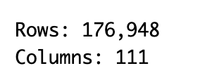
Final Cleaned Merged DataFrame
The dataset has 176,948 rows and 111 columns, representing various attributes related to energy consumption and building characteristics. Key points include:
Columns cover building details, climate zones, amenities, income, weather, and energy-related information.
Information on daily electricity consumption is available.
Geographic details include latitude and longitude.
Meteorological data includes temperature, humidity, wind speed, and radiation.
Upgrade information is present for insulation, water heaters, HVAC systems, etc.
Building characteristics like size, vintage, and occupancy are included.

Slide 9
Model Building
1.Linear Regression
Linear regression is a statistical method used for modeling the relationship between a dependent variable and one or more independent variables by fitting a linear equation to observed data. The goal of linear regression is to find the best-fitting linear relationship that minimizes the sum of the squared differences between the observed and predicted values.The linear regression equation for a simple linear regression with one independent variable is typically represented as:
Y = bX + c
Y is the dependent variable (the one you're trying to predict).
X is the independent variable (the one used to make predictions).
c is the y-intercept (the value of Y when X is 0).

Slide 10
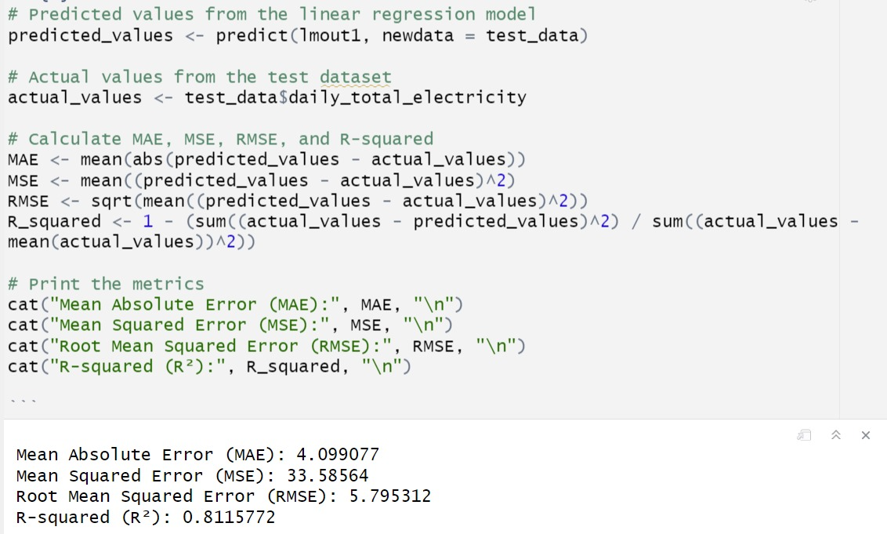
Model Accuracy
The Linear Regression model achieved an accuracy of 81.16%.

Slide 11
Model Building
2.XGBoost
XGBoost stands for “Extreme Gradient Boosting”,It is used for supervised learning problems, where we use the training data (with multiple features) to predict a target variable.Before we learn about trees specifically, let us start by reviewing the basic elements in supervised learning. In simple terms, it builds multiple decision trees sequentially, each trying to correct the errors of the previous one. The final prediction is the sum of the predictions from all the trees.
Formula:
Final Prediction=Prediction from 1st Tree+Prediction from 2nd Tree+…+Prediction from Last Tree Final
Each tree is trained to focus on the mistakes made by the ensemble of previous trees, making XGBoost effective and accurate for various tasks like regression and classification.
Final Prediction=Prediction from 1st Tree+Prediction from 2nd Tree+…+Prediction from Last Tree

Slide 12
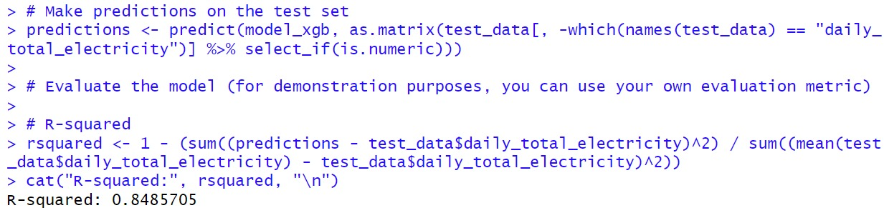
The XGBoost model achieved an accuracy of 84.85%

Slide 13
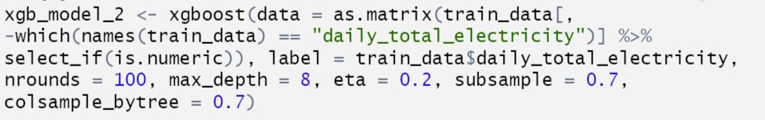
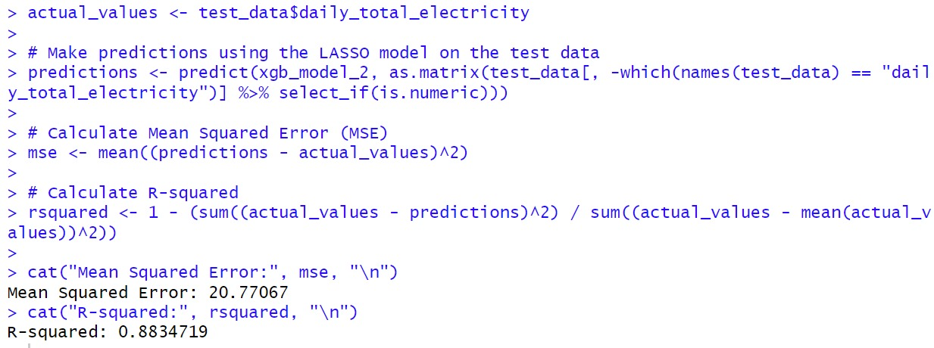

Slide 14
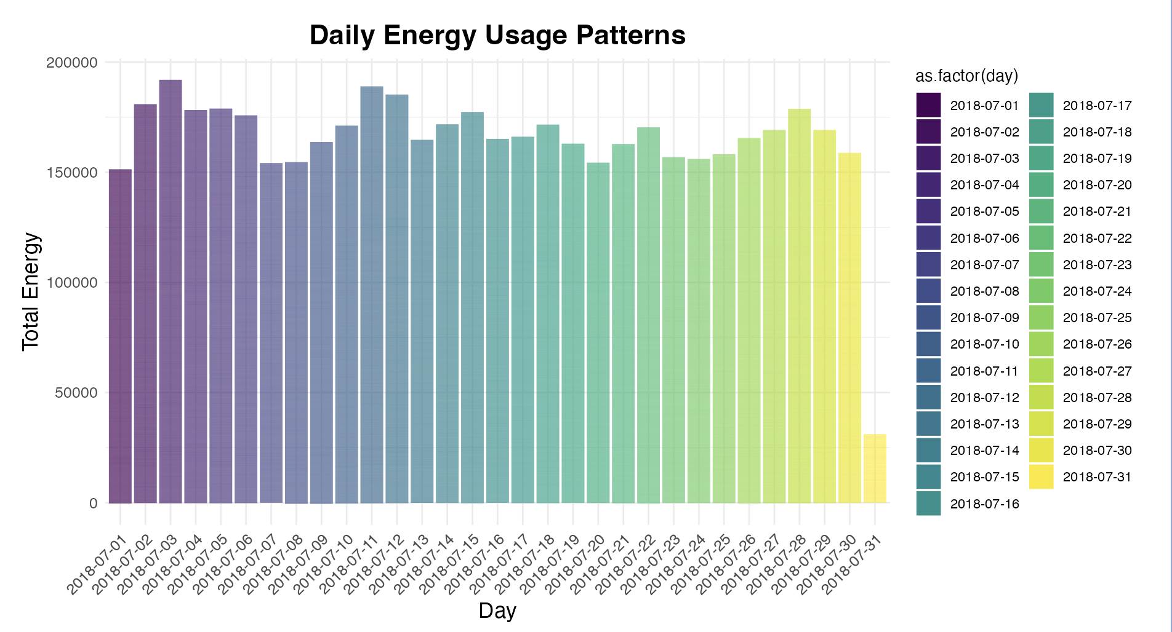
Visualization

Slide 15
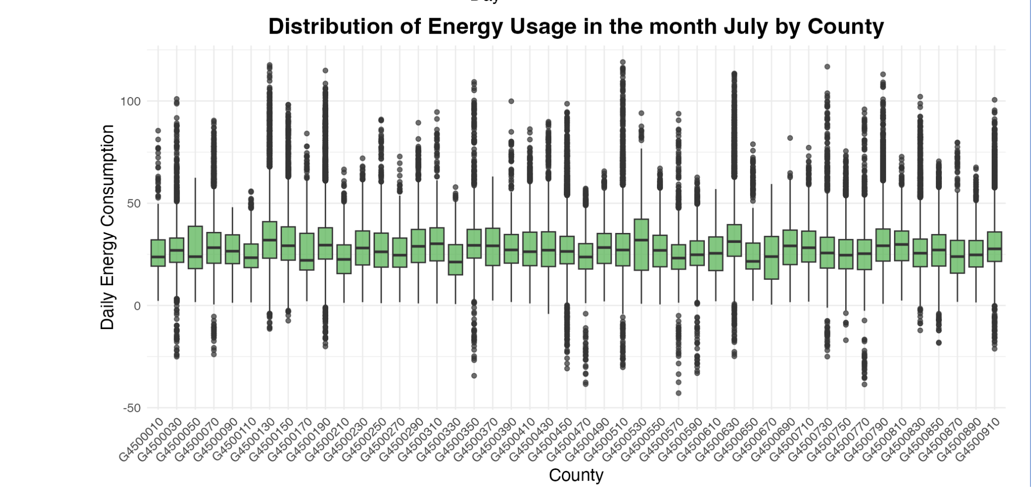

Slide 16
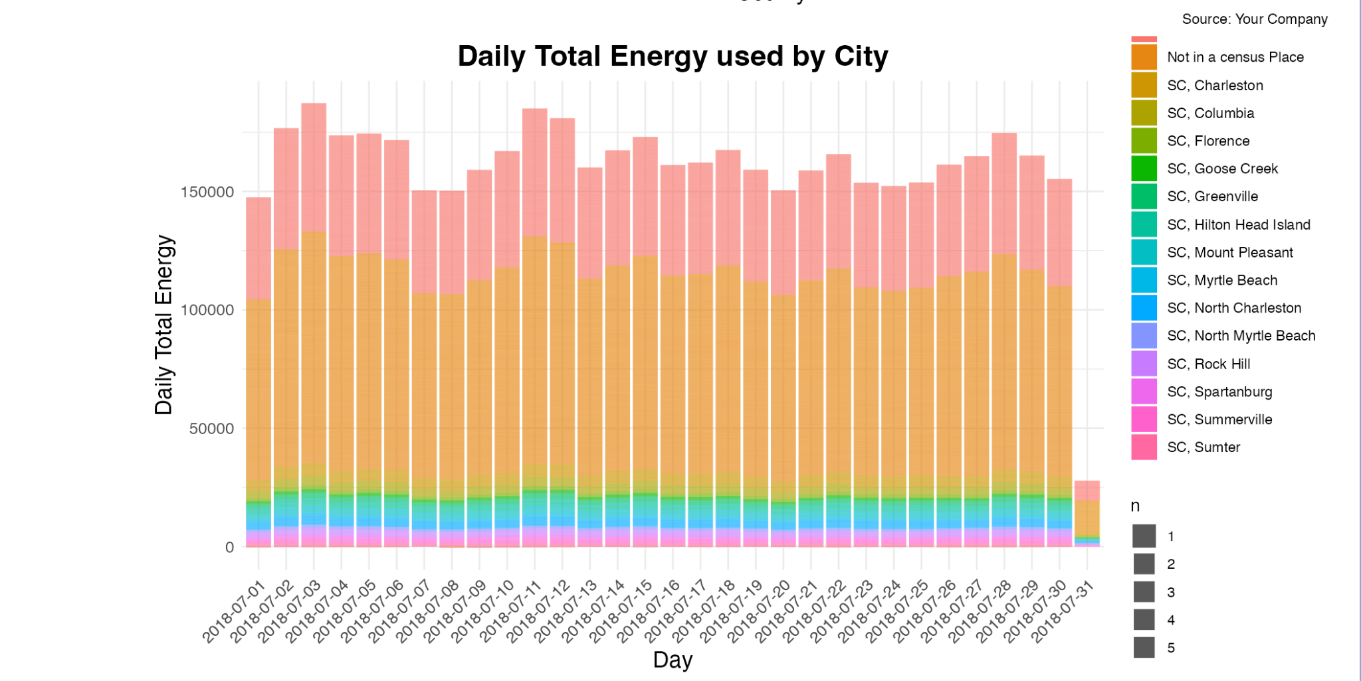

Slide 17
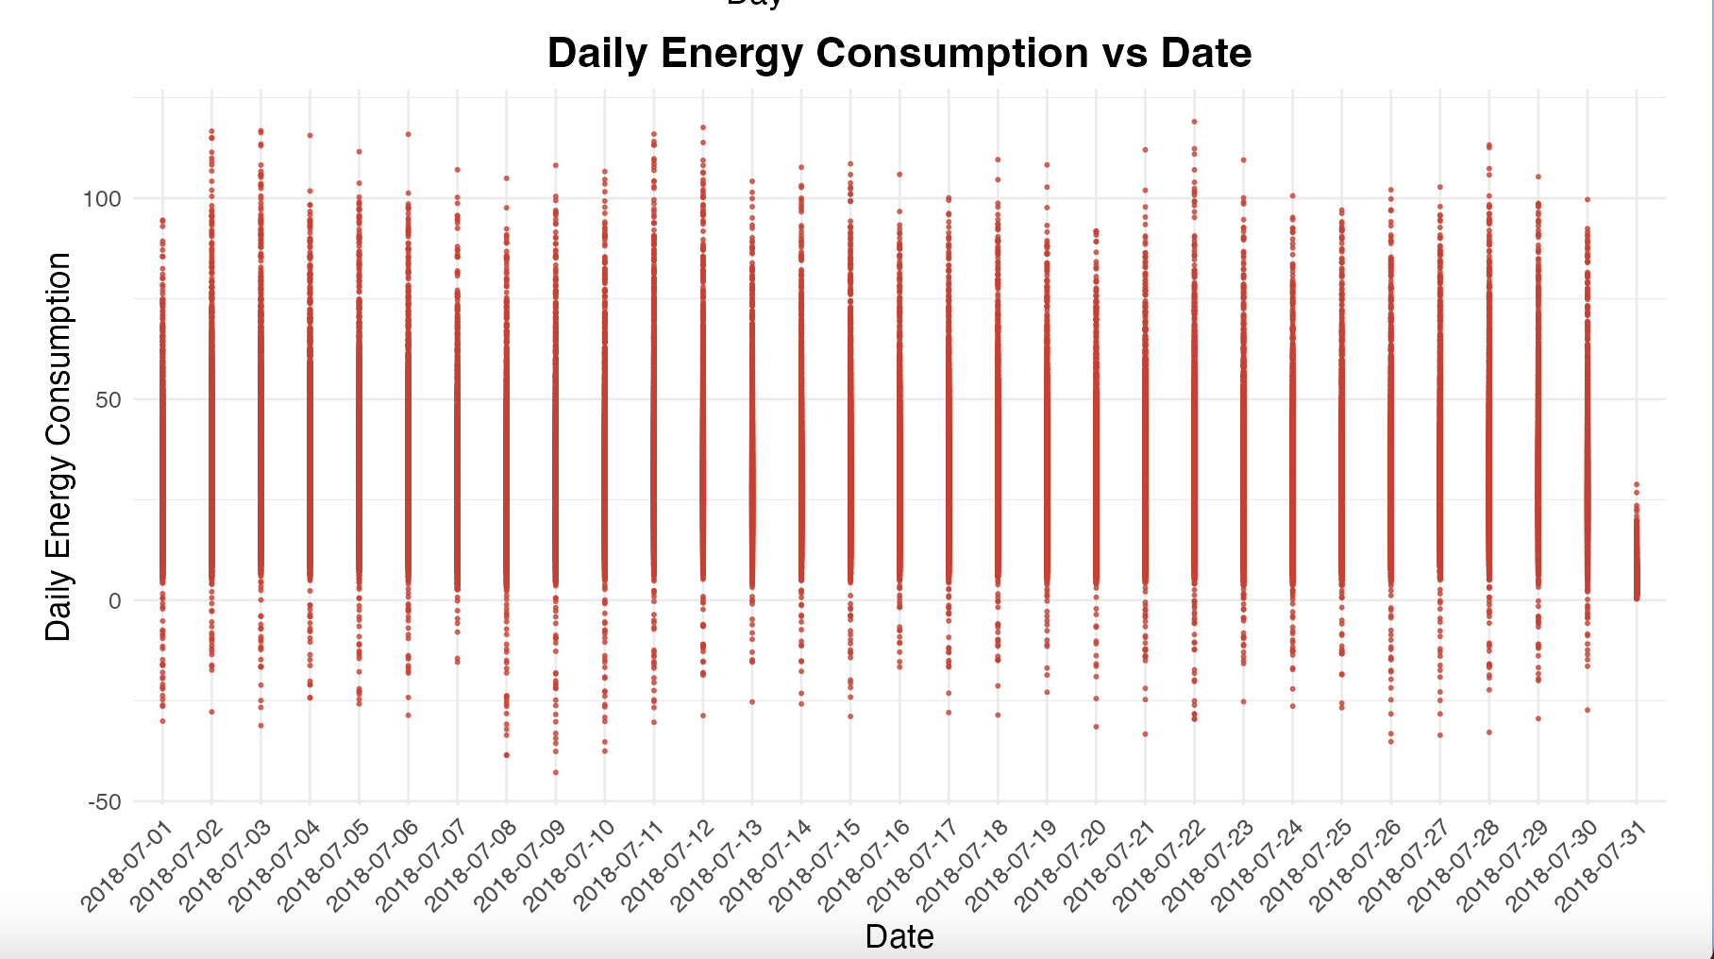

Slide 18
Interpretation of the results/Actionable Insights
The suggestions for interpreting XGBoost model results for actionable insights are as follows:
Feature Importance: Identify factors with the greatest influence on energy usage, guiding efficiency programs.
Partial Dependence Plots: Visualize the impact of key features (e.g., temperature) on predicted energy usage, especially during extreme conditions.
Individual Conditional Expectations (ICE): Identify subsets of houses with high weather sensitivity for tailored upgrades and incentives.
Distribution of Predictions:Analyze prediction distribution to estimate peak load requirements under current and future warming scenarios.
Prediction Error: Evaluate prediction accuracy geographically to identify areas for additional meteorological sensors or where relationships differ.

Slide 19


